Slide 1
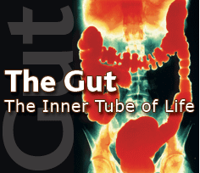
Nutrition and digestion

Slide 2
Nutrition
-Carbohydrates, proteins, and lipids
-Essential nutrients
amino acids
fatty acids
minerals
vitamins
-The enough but not too much principle

Slide 3
Most animals are heterotrophs (or chemoheterotrophs if you are either pedantic or taking BIO 2022).
They obtain their nutrients mostly from organic sources: from plants, from other animals, or from microbes and fungi.
“I am food, I am food. I am the eater of food,..”
The Upanishads (ancient Hindu text)
What do animals get from these resources?

Slide 4
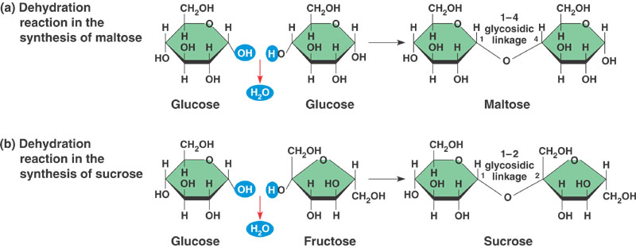
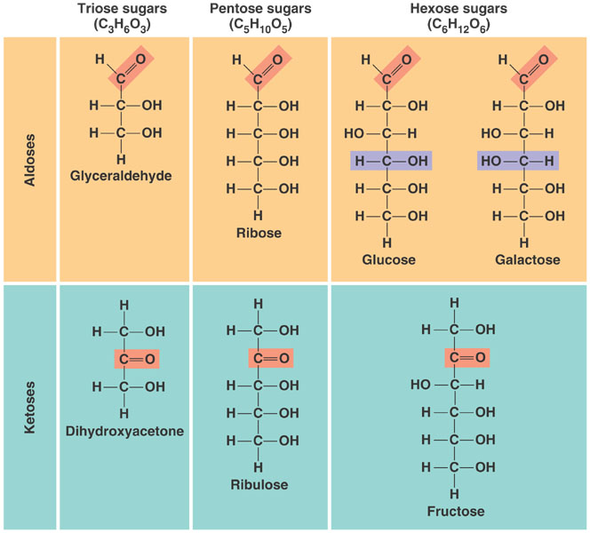
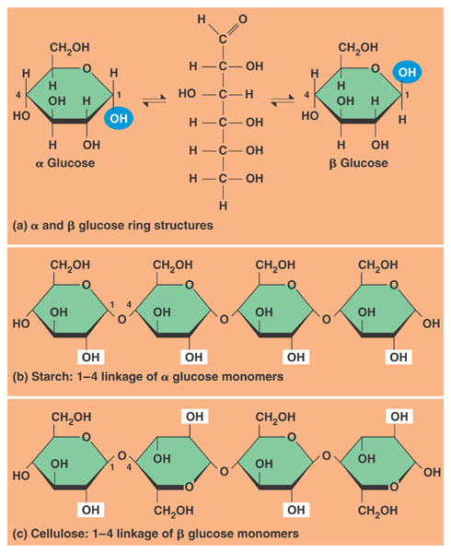
Carbohydrates can be divided into monosaccharides (the most important nutritional hexoses are glucose, fructose, and galactose); disaccharides (sucrose, maltose, and lactose); and
polysaccharides (starch and glycogen). Starch is the primary energy storage molecule in plants. Glycogen is the most important polysaccharide in animals.

Slide 5
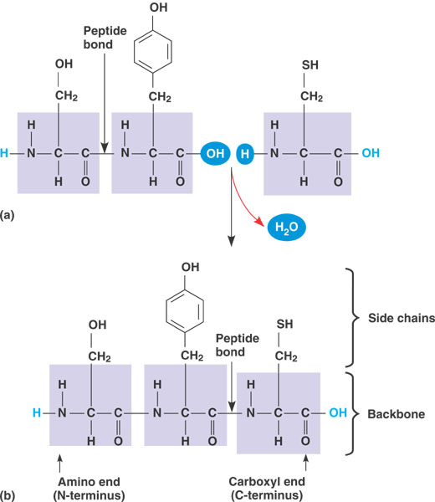
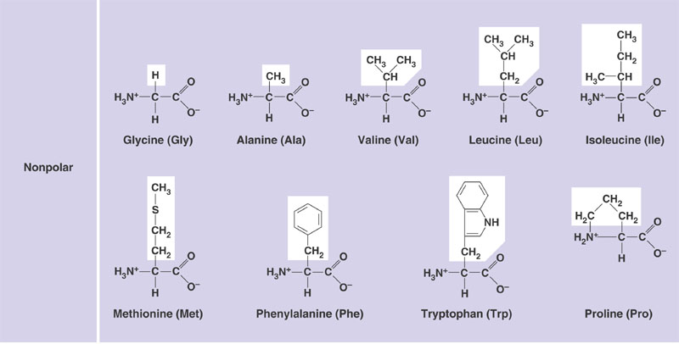
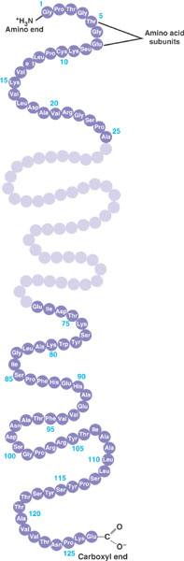
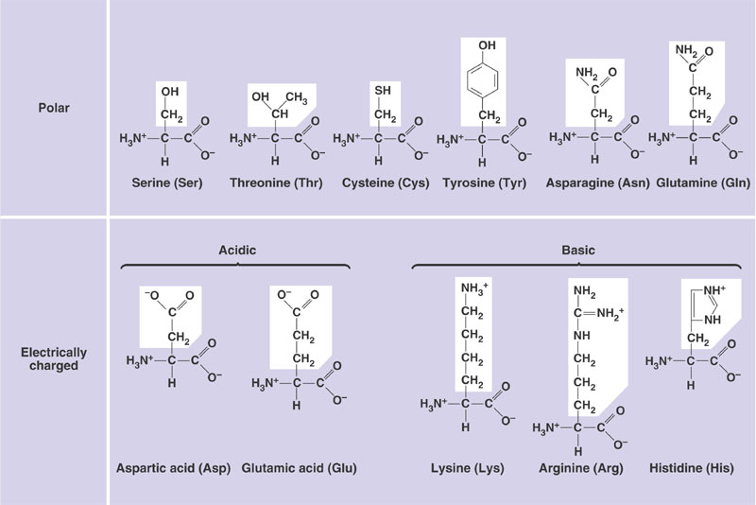
Proteins are polymers of 20 amino acids joined by peptide bonds.
The tertiary and quaternary structure of proteins determines their function.

Slide 6
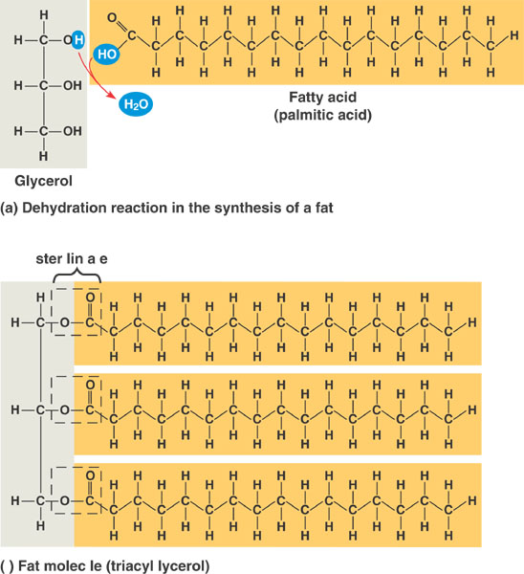
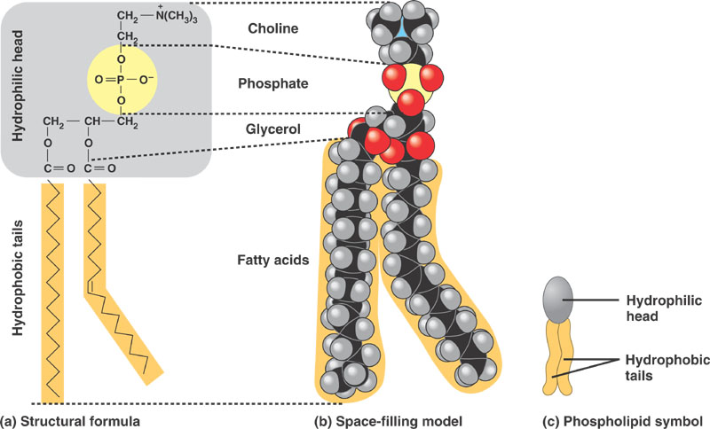
To remember about lipids
-Triacylglycerides are esters of glycerol and fatty acids.
-They are good sources of energy and the energy storage of choice in animals (why? Two reasons?).
-Important components of biological membranes (Why?)

Slide 7
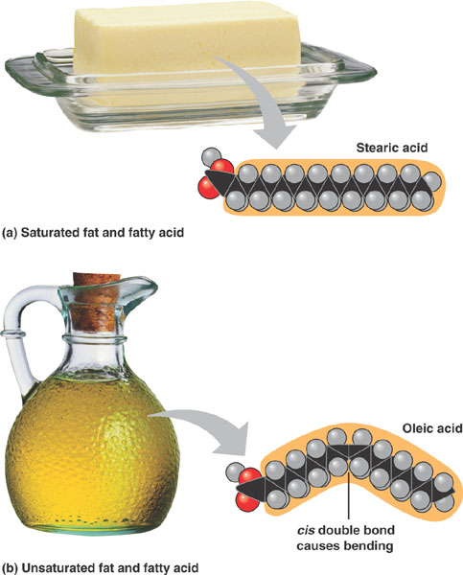
Long
And saturated FAs have high melting points (lards)
Short
and unsaturated FAs have low melting points (oils)
18 Carbons
Fatty acids without double bonds are called saturated. Those with double bonds are called unsaturated. Melting point is lower in unsaturated FAs and in short- than in long-chained fatty acids.

Slide 8
TO REMEMBER
-The most important dietary monosaccharides (hexoses) are glucose, fructose, and galactose.
-The most important dietary disaccharides are sucrose (G-F), maltose (G-G), and galactose (lactose-glucose).
-Starch (plants) and glycogen (animals) are important dietary polysaccharides.
-Proteins are polymers of 20 amino acids joined by peptide bonds.
-Lipids (fatty acids, phospholipids, cholesterol, triacylglycerides) are non-polar molecules. Triacylglycerides are made of fatty acids and glycerol. Many lipids are amphipathic
-Fatty acids without double bonds are called saturated. Those with double bonds are called unsaturated. Melting point is lower in unsaturated than in saturated FAs and in short- than in long-chained fatty acids.

Slide 9
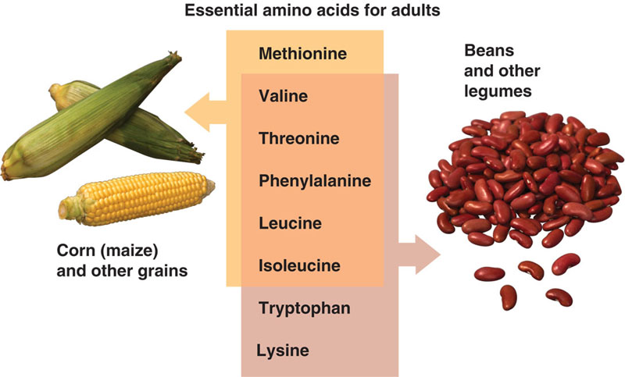
Some nutrients are indispensable (essential)
Indispensable means that the animals cannot synthesize them in sufficient amounts and hence it must obtain them in food. A nutrient can be indispensable because the animal lacks the metabolic pathway to make it, or because it has limited ability to make enough of the nutrient.
BROAD PRINCIPLE
There are 8 indispensable amino acids but a few others are
“conditionally indispensable” (arginine is indispensable in cats and can be indispensable during wound/burn healing).

Slide 10
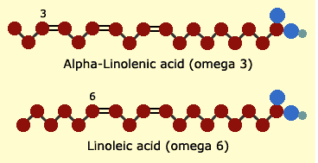
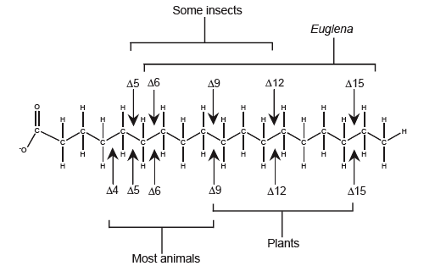
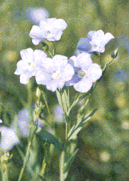
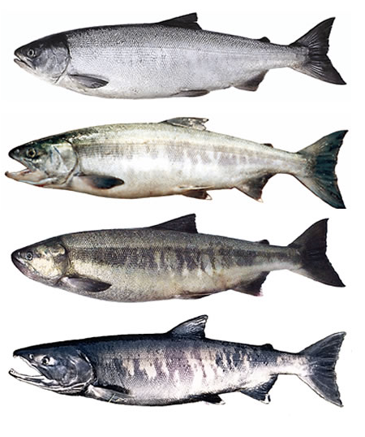
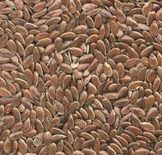
There are two essential fatty acids. They are essential because animals do not have the ability to place a double bond beyond carbon 9 of the fatty acid (counting from the carboxyl end)
Linseed from flax
Desaturases

Slide 11
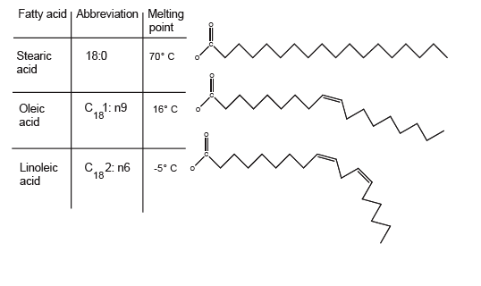
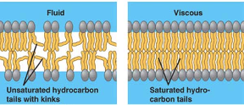
Essential fatty acids are important because they are
precursors of important signaling molecules (such as prostaglandins)
and
b) because they maintain the fluidity of biological membranes.

Slide 12
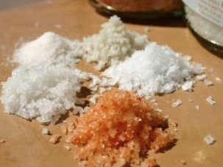
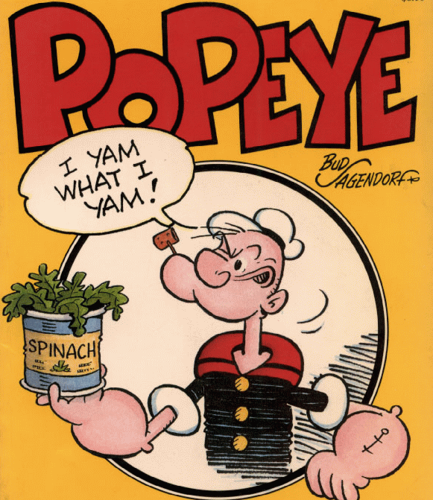
Minerals
Inorganic nutrients usually required in small amounts
Mineral Source Function
Calcium dairy, legumes, some vegetables skeleton, signaling
Phosphorous dairy, meat, some grains skeleton, nucleic acids
Sulfur animal protein component of some *amino acids
Chlorine table salt acid-base balance, gastric juice
Sodium table salt nerve function, many others
Iron meat, some vegetables hemoglobin, enzyme co-factor
Iodine sea food, iodized salt component of thyroid hormones
(many others: Fluorine, Zinc, Copper, Manganese, Cobalt Selenium, Chromium, Molybdenum…)
*methionine and cysteine

Slide 13
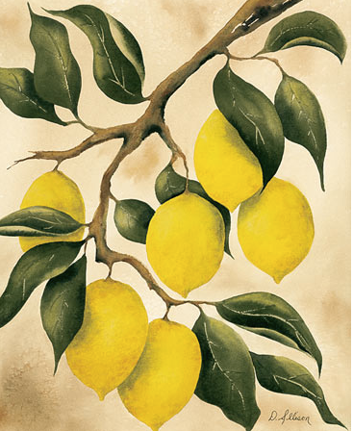
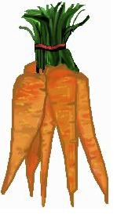
BROAD PRINCIPLE
Vitamins
Organic molecules required in small amounts. Vitamins have very diverse functions….
Water soluble Source Function
Vitamin C fruits (citrus), vegetables collagen synthesis, immunity
Niacin nuts, meat, grains component of NAD+ and NADP+
Lipid soluble
Vitamin A Green and orange vegetables visual pigments, antioxidant
Vitamin D Dairy, egg yolk, fish absorption and use of Ca and P
Excess of water soluble vitamins is excreted in urine (moderate overdoses are more or less harmless). Excess of lipid soluble vitamins is stored in fat and therefore overdoses may result in toxic effects.

Slide 14
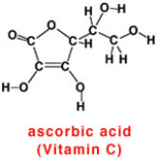
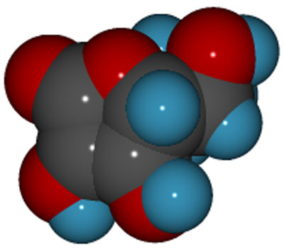
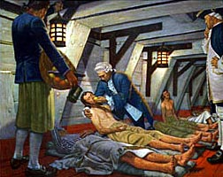
Functions: antioxidant, synthesis of collagen, synthesis of carnitine (aids fatty acid entry into mitochondria, biosynthesis of norepinephrine,..,etc.).
Symptoms of avitaminosis: Scurvy. In this condition the structure of collagen is defective and people end up with spongy gums, bleeding from mucous membranes, liver spots in legs.
Sources: fresh fruit (citrus, rose hips), liver.

Slide 15
Things to Remember
-An indispensable (essential) nutrient is a nutrient than an animal cannot synthesize by itself.
-There are 8 indispensable amino acids.
-There are 2 indispensable fatty acids (linoleic and linolenic)
-Essential fatty acids are important because they are precursors of signaling molecules and because they increase the fluidity of membranes.
-Animals require a bunch of minerals (please recall the function of iron, sodium, and sulfur).
-Vitamins are organic molecules required in small amounts.
-Water soluble vitamins (VC and Niacin) are excreted in urine. Lipid solubles are stored in fat and over-ingestion can be toxic.
-The effect of many minerals and vitamins follows the “enough but not too much” principle.

Slide 16
Digestive Physiology
-The concept of assimilation
-A variety of gut designs
-The human gut and its glands
-An overview of nutrient assimilation
-Lactose intolerance
-Glucose transport

Slide 17
How do animals assimilate nutrients
Assimilation = Digestion + Absorption
to digest is to break up a large molecule into smaller ones.
Assimilation (most often takes place in the gastrointestinal tract). There are exceptions… Arachnids inject digestive enzymes into their prey.

Slide 18
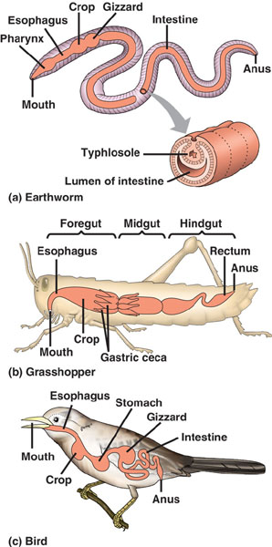
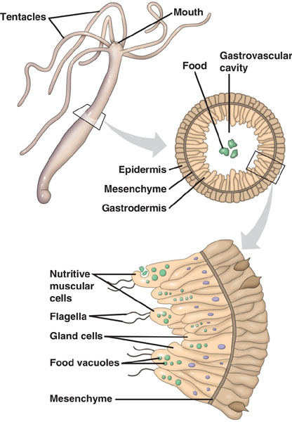
Guts!

Slide 19
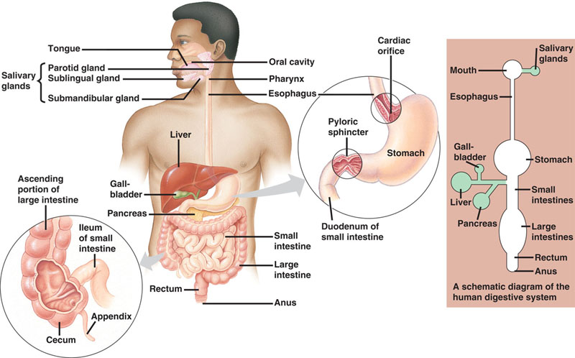
The digestive system in many (but not all) animals is a saculated tube into which many glands empty their contents.

Slide 20
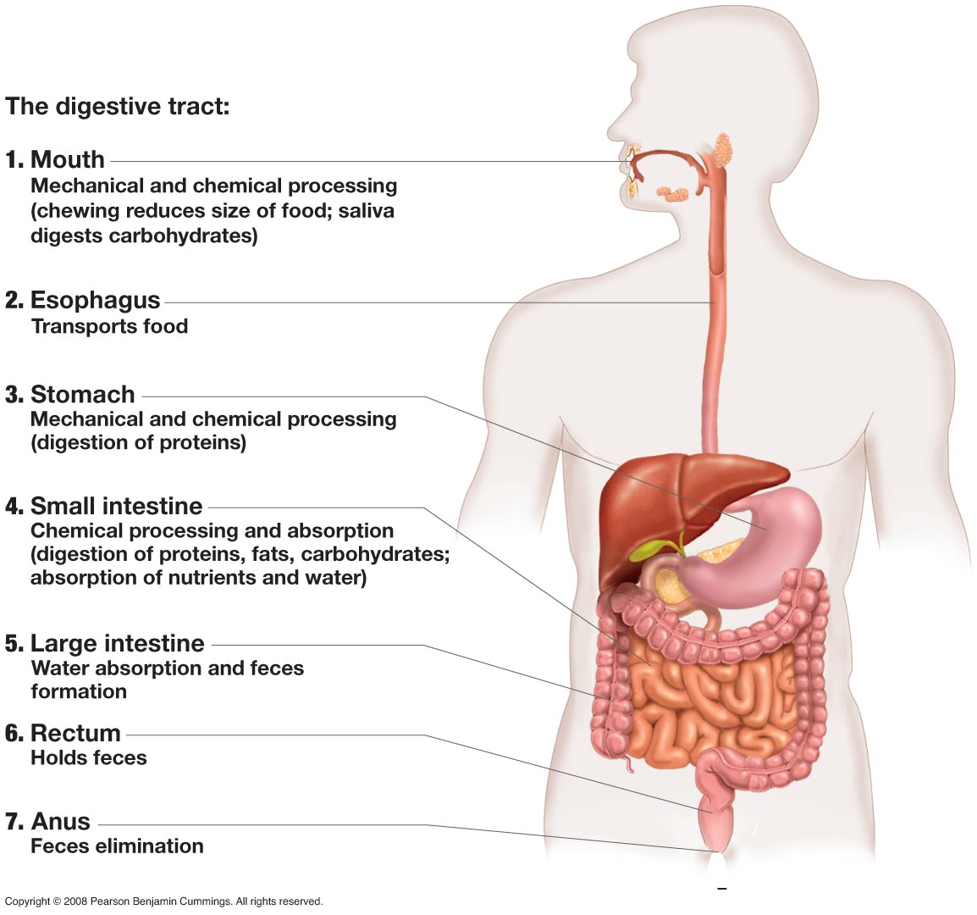

Slide 21
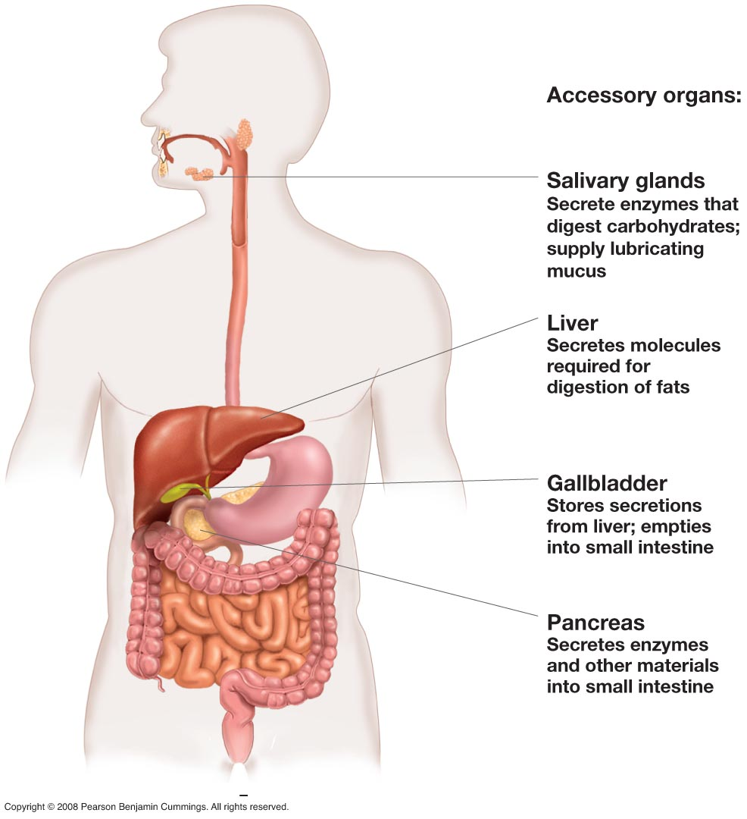

Slide 22
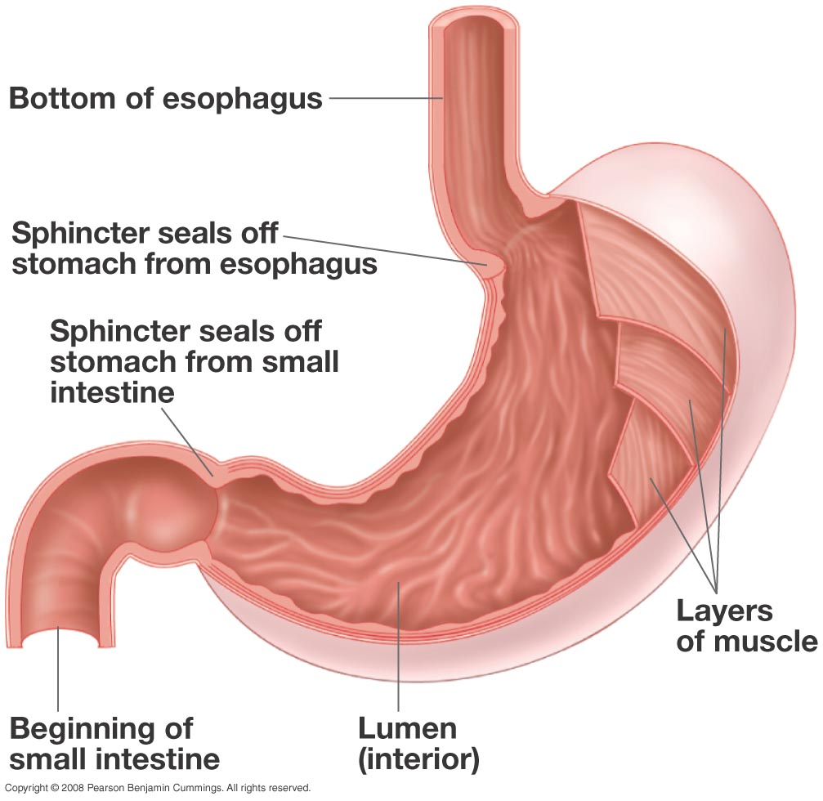

Slide 23
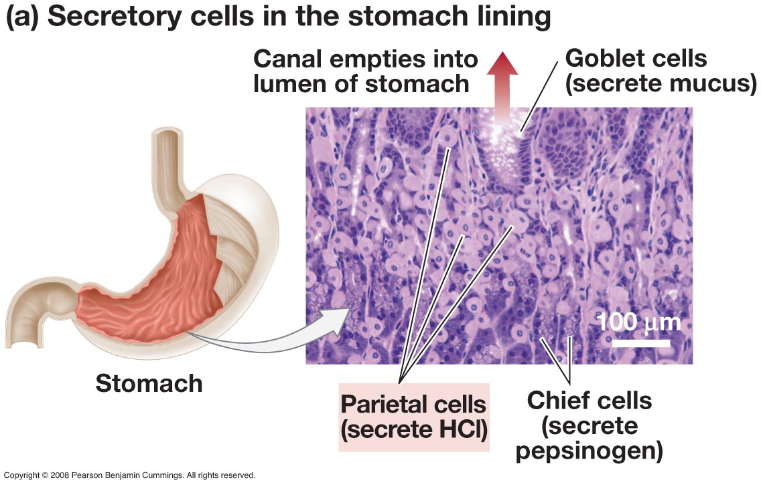
The HCl helps in the hydrolysis of protein.
Pepsinogen is the precursor of pepsin

Slide 24
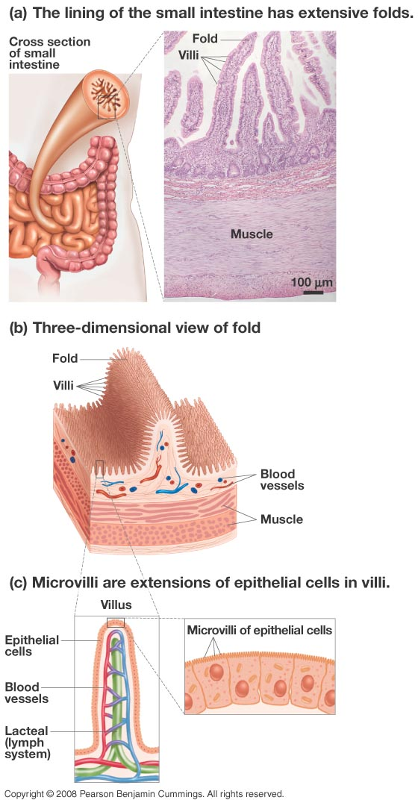
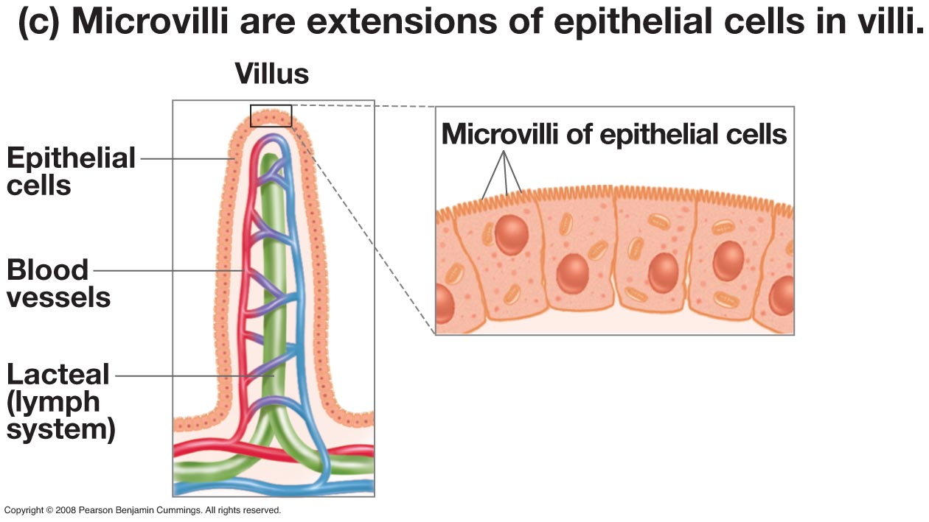

Slide 25
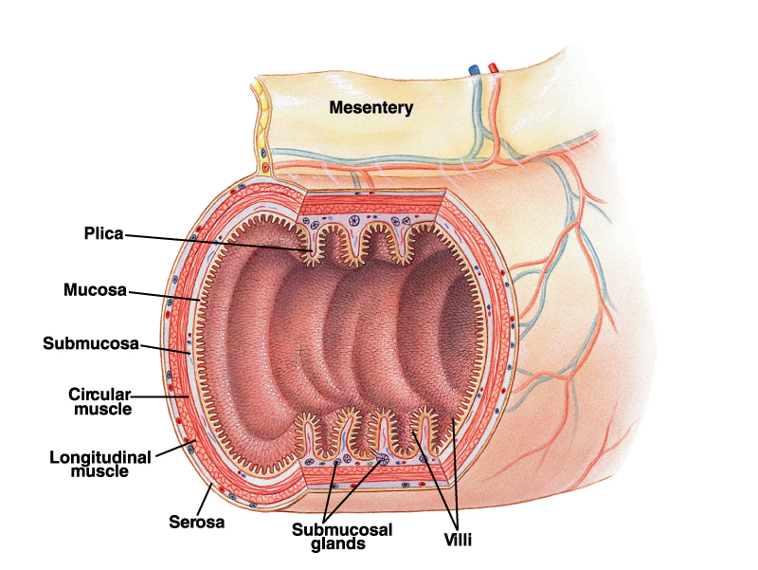
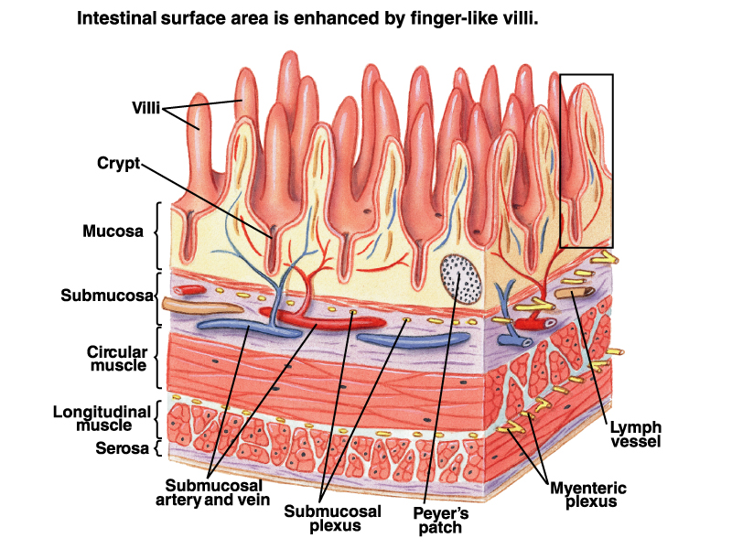
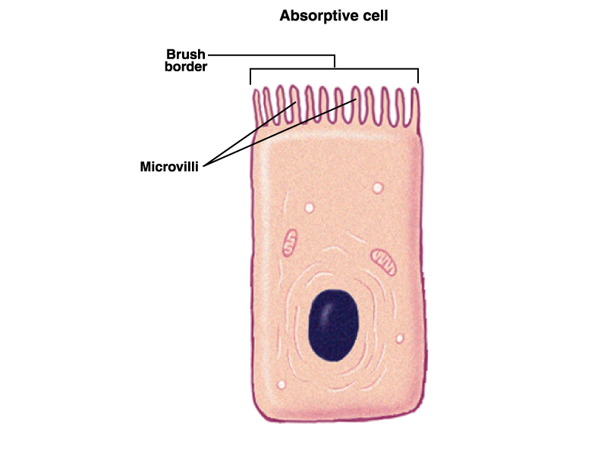
Nominal area ≈3.3 m²
Addition of folds of Kerkring ≈ 10 m²
Addition of villi to
Folds of Kerkring ≈100 m²
Addition of microvilli to
villi ≈2,000 m²
Absorptive surfaces maximize their area by successive levels of folding.

Slide 26
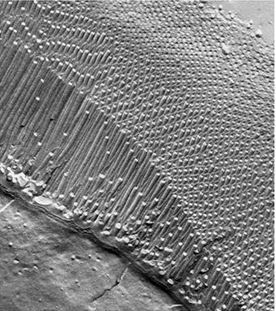
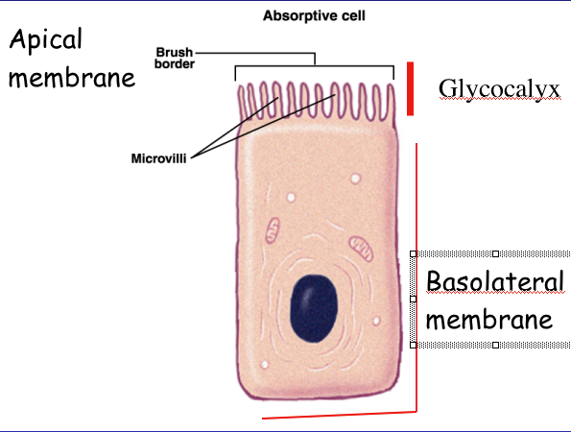
The cells of the intestine are called enterocytes
Gr. Enteron = gut
Cytos = cell

Slide 27
To Remember
The digestive process consists of four steps: ingestion, digestion, absorption, and elimination (defecation).
Nutrient assimilation consists of 2 steps: digestion and absorption
The GI tract is a saculated tube with many glands.
The digestive and absorptive surfaces of the GI tract often increase their surface area by multiple levels of folding.
Intestinal epithelial cells are called enterocytes

Slide 28
Why would a person with a weak esophageal sphincter complain of “heartburn”?
The sphincter is inhibiting the passage of food into the stomach from the esophagus, causing the esophagus to swell.
The sphincter is not allowing the passage of bile salts from the esophagus to the small intestine.
The sphincter is allowing regurgitation of stomach acids into the relatively unprotected esophagus.
All of the above answers apply.
Notes:
Answer: C

Slide 29
Why is it that the small intestine has so much more surface area than other major digestive organs?
Its huge surface area allows production of sufficient hydrochloric acid for digestion.
Because the small intestine is involved in mixing and breaking up food mechanically.
The extra surface area allows the small intestine to secrete enough enzymes for digestion.
Its huge surface area makes highly efficient absorption of nutrients into the bloodstream possible.
Notes:
Answer: D

Slide 30
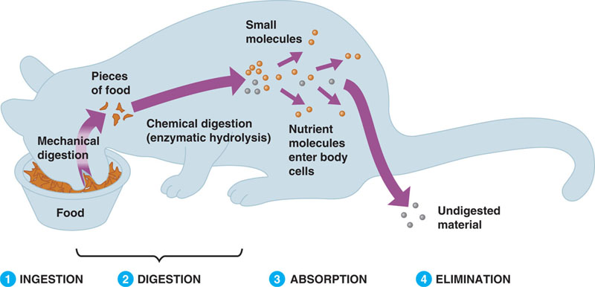
The process of assimilation can be divided into several steps:
Luminal (extracellular) digestion ---> membrane digestion
Often, enzymatic digestion has two steps.

Slide 31
This aplies to all types of nutrients EXCEPT lipids
The assimilation process
luminal
enzymatic
digestion
membrane
enzymatic
digestion
physical
processing
uptake/transport
BROAD PRINCIPLE

Slide 32
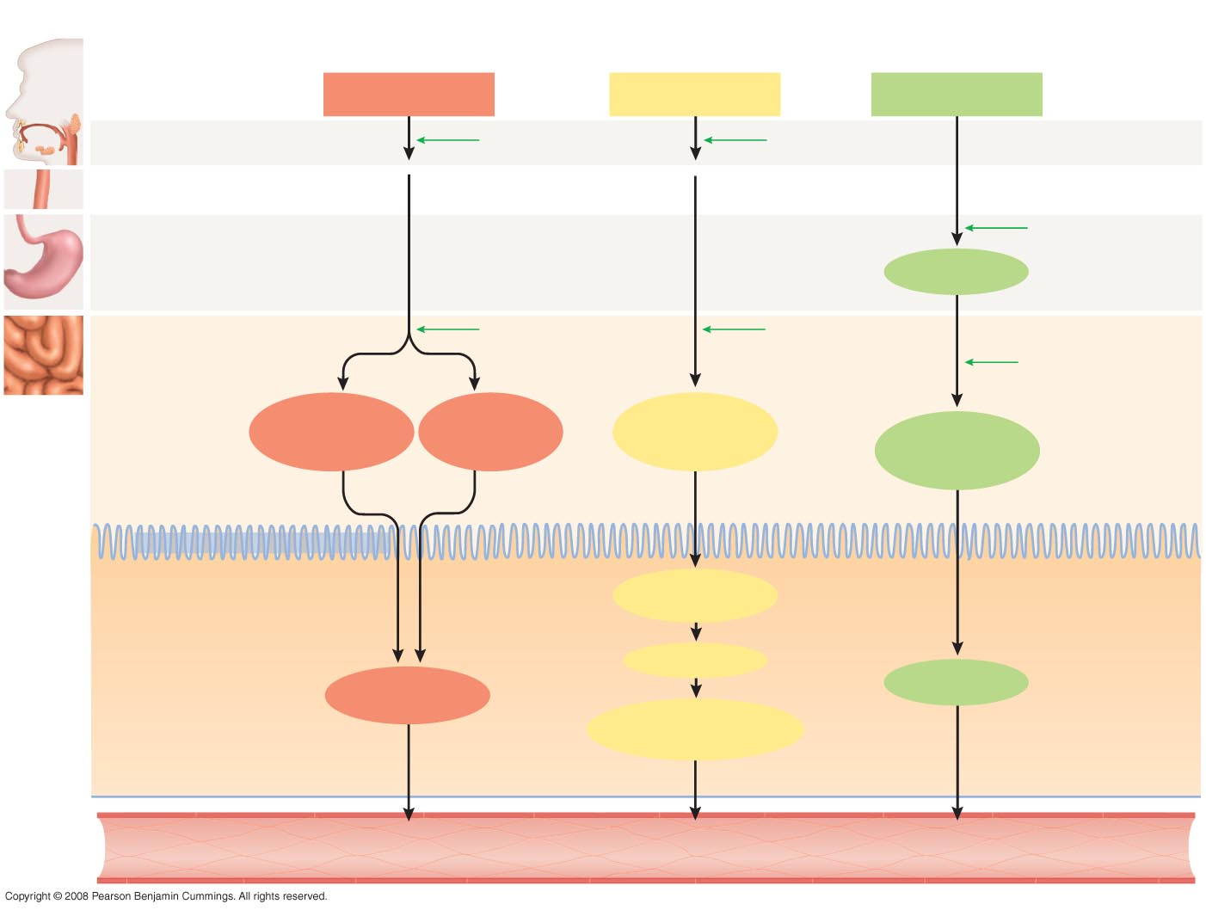
Figure 43-6
Slide 5
Location in
digestive
tract
Carbohydrates
Lipids
Proteins
1. Mouth
Salivary amylase
Lingual lipase
2. Esophagus
Pepsin
3. Stomach
Polypeptides
4. Small intestine
Pancreatic
α-amylase
Bile salts
and pancreatic
lipase
Trypsin
Chymotrypsin
Elastase
Carboxypeptidase
Lumen
of small
intestine
Monosaccharides
(simple sugars)
Disaccharides
Trisaccharides
Monoglycerides
Fatty acids
Short peptides
Amino acids
DIFFUSION
Cell membrane of epithelial cell
FACILITATED
DIFFUSION AND
COTRANSPORT
Monoglycerides
Fatty acids
FACILITATED
DIFFUSION AND
COTRANSPORT
Epithelium of
small intestine
Triglycerides
Monosaccharides
Amino acids
Chylomicrons (protein-
coated globules)
FACILITATED
DIFFUSION AND
COTRANSPORT
FACILITATED
DIFFUSION
EXOCYTOSIS
To bloodstream
To lymph vessels,
then bloodstream
To bloodstream

Slide 33
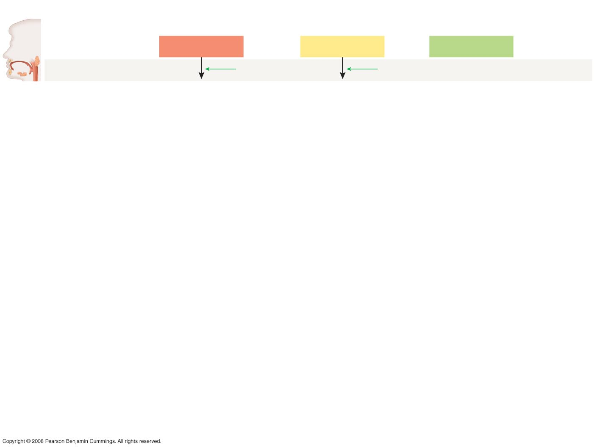
Figure 43-6
Slide 1
Location in
digestive
tract
Carbohydrates
Lipids
Proteins
1. Mouth
Salivary amylase
Lingual lipase

Slide 34
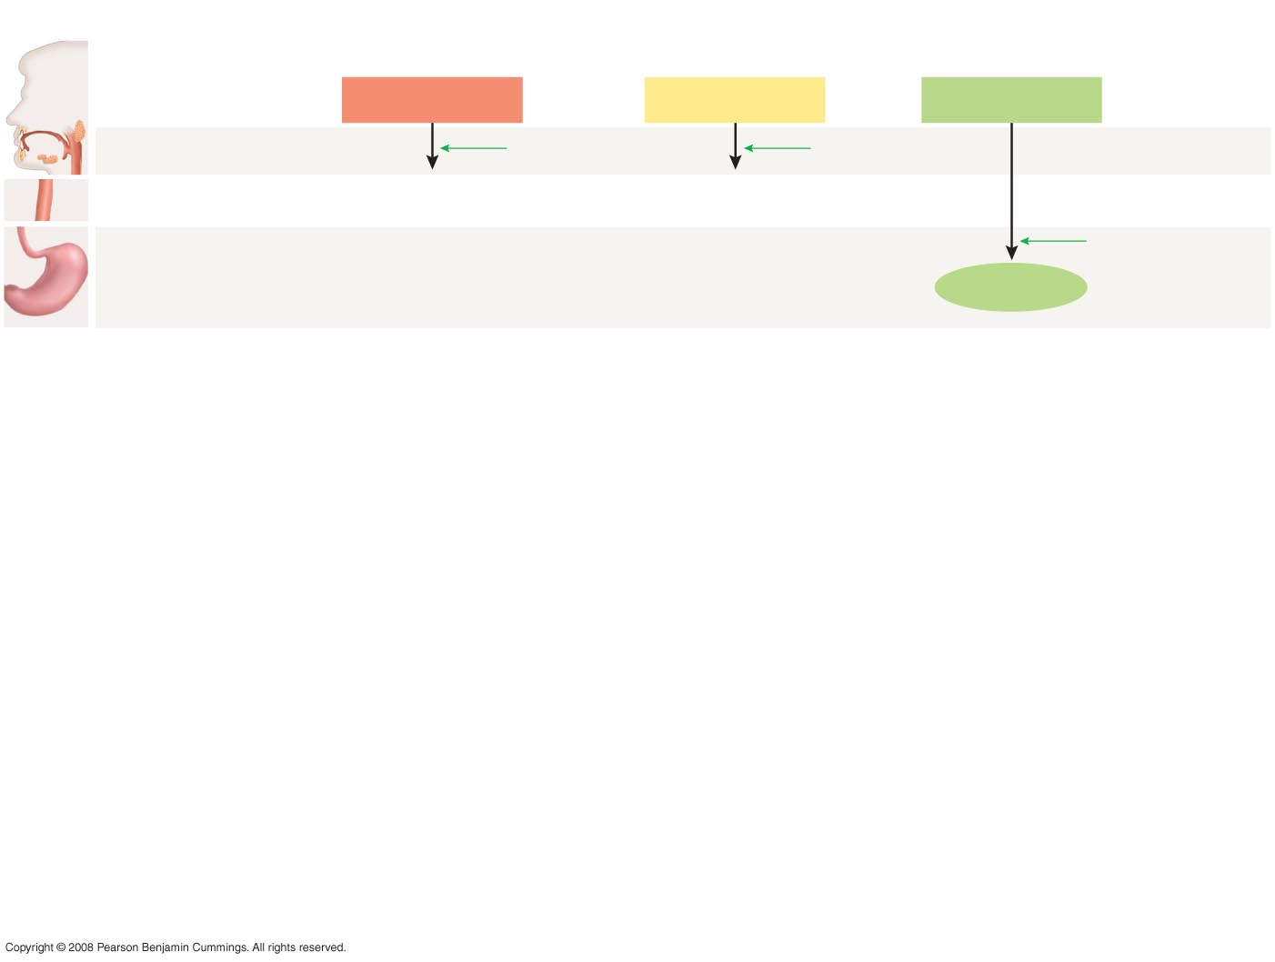
Figure 43-6
Slide 2
Location in
digestive
tract
Carbohydrates
Lipids
Proteins
1. Mouth
Salivary amylase
Lingual lipase
2. Esophagus
Pepsin
3. Stomach
Polypeptides

Slide 35
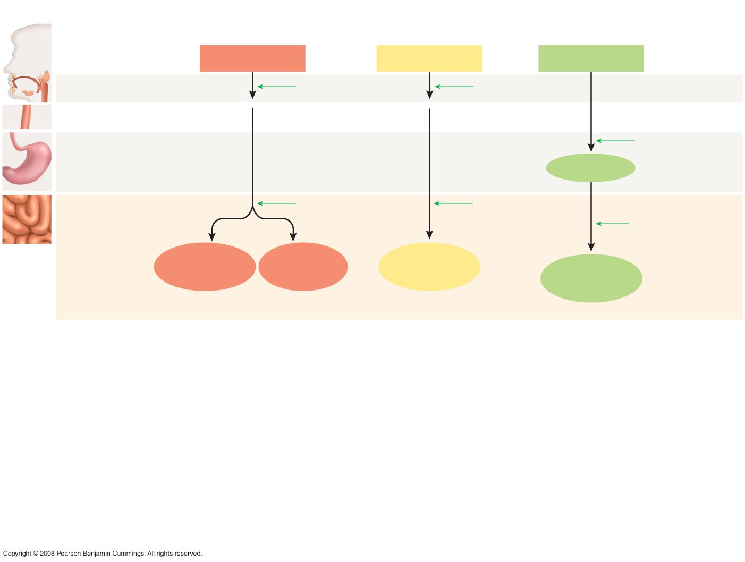
Figure 43-6
Slide 3
Location in
digestive
tract
Carbohydrates
Lipids
Proteins
1. Mouth
Salivary amylase
Lingual lipase
2. Esophagus
Pepsin
3. Stomach
Polypeptides
4. Small intestine
Pancreatic
α-amylase
Bile salts
and pancreatic
lipase
Trypsin
Chymotrypsin
Elastase
Carboxypeptidase
Lumen
of small
intestine
Monosaccharides
(simple sugars)
Disaccharides
Trisaccharides
Monoglycerides
Fatty acids
Short peptides
Amino acids

Slide 36
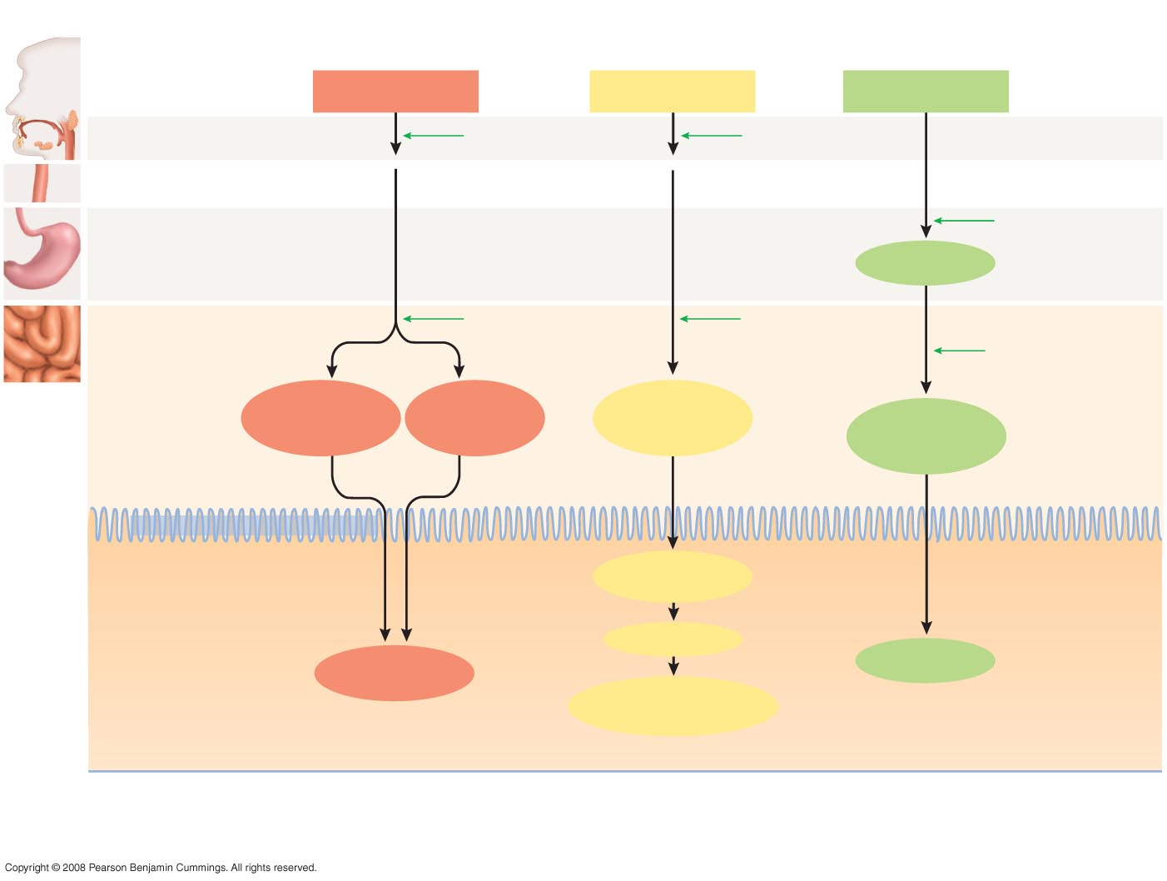
Figure 43-6
Slide 4
Location in
digestive
tract
Carbohydrates
Lipids
Proteins
1. Mouth
Salivary amylase
Lingual lipase
2. Esophagus
Pepsin
3. Stomach
Polypeptides
4. Small intestine
Pancreatic
α-amylase
Bile salts
and pancreatic
lipase
Trypsin
Chymotrypsin
Elastase
Carboxypeptidase
Lumen
of small
intestine
Monosaccharides
(simple sugars)
Disaccharides
Trisaccharides
Monoglycerides
Fatty acids
Short peptides
Amino acids
DIFFUSION
Cell membrane of epithelial cell
FACILITATED
DIFFUSION AND
COTRANSPORT
Monoglycerides
Fatty acids
FACILITATED
DIFFUSION AND
COTRANSPORT
Epithelium of
small intestine
Triglycerides
Monosaccharides
Amino acids
Chylomicrons (protein-
coated globules)

Slide 37
Figure 43-6
Slide 5
Location in
digestive
tract
Carbohydrates
Lipids
Proteins
1. Mouth
Salivary amylase
Lingual lipase
2. Esophagus
Pepsin
3. Stomach
Polypeptides
4. Small intestine
Pancreatic
α-amylase
Bile salts
and pancreatic
lipase
Trypsin
Chymotrypsin
Elastase
Carboxypeptidase
Lumen
of small
intestine
Monosaccharides
(simple sugars)
Disaccharides
Trisaccharides
Monoglycerides
Fatty acids
Short peptides
Amino acids
DIFFUSION
Cell membrane of epithelial cell
FACILITATED
DIFFUSION AND
COTRANSPORT
Monoglycerides
Fatty acids
FACILITATED
DIFFUSION AND
COTRANSPORT
Epithelium of
small intestine
Triglycerides
Monosaccharides
Amino acids
Chylomicrons (protein-
coated globules)
FACILITATED
DIFFUSION AND
COTRANSPORT
FACILITATED
DIFFUSION
EXOCYTOSIS
To bloodstream
To lymph vessels,
then bloodstream
To bloodstream

Slide 38
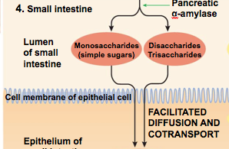
Error!!!!
Di- and Trisaccharides are NOT taken up by the intestinal cells. They are first broken up by membrane-bound enzymes into monosaccharides.

Slide 39
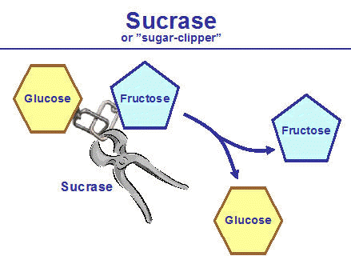
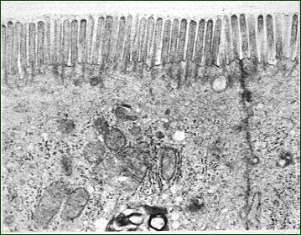
Sucrose
Glucose + Fructose
SUCRASE

Slide 40
luminal
enzymatic
digestion
membrane
enzymatic
digestion
physical
processing
uptake/transport
many transport proteins attached to the brush-border of intestinal cells
enzymes secreted by
salivary glands
(amylase,
lipase)
stomach (pepsin)
pancreas
(amylase,
trypsin,
lipase)
enzymes attached to the brush-border of intestinal cells
(lactase, sucrase)
BROAD PRINCIPLE

Slide 41
To Remember
1) For many nutrients, the process of assimilation consists of four steps: physical processing, luminal digestion, membrane digestion, and uptake/transport.
2) The glands that secrete the enzymes that act in the lumen of the gastrointestinal tract are: the salivary gland, the stomach, and the pancreas.
3) Disaccharides must be hydrolyzed (broken down) into monosaccharides

Slide 42
The evolution of lactose tolerance in
Homo sapiens (sapiens?)
-We are mammals.
-Mammals are hairy, warm blooded (endothermic
homeotherms), viviparous vertebrates, that feed
their young on milk.
-Milk is a heterogeneous solution (its composition
varies from species to species) that contains proteins,
Lipids, carbohydrates, electrolytes, and vitamins.

Slide 43
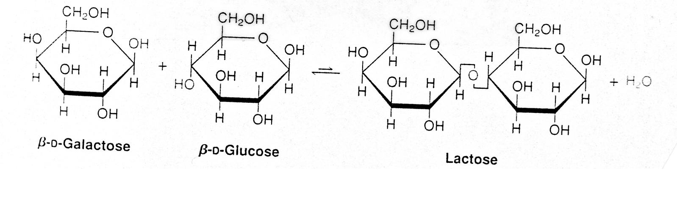
Lactose
-Lactose is the primary carbohydrate
in mammalian milk (a few marsupials
secrete oligosaccharides of galactose).
-Lactose is a disaccharide made of galactose
and glucose joined by a 1-4 β bond.
-Lactose is very rare in nature except in milk.
Glucose + Galactose
SGLT1
Lactase

Slide 44

-lactose intolerance is a genetically determined trait
-It has simple Mendelian genetics (tolerance is dominant,
intolerance is recessive).
-Lactose intolerance is the ancestral condition in humans
-Lactose tolerance evolved twice in humans, how come?
in both cases as a result of “coevolution” with domestic ungulates (cows, goats, and camels).

Slide 45
Hypotheses to explain the evolution of lactose tolerance
Pastoralism (nutritional advantage, sensu stricto. Low latitudes)
Calcium absorption (high latitudes)
  The low availability of sunlight, and hence low synthesis of Vit. D is the the selective agent
  Milk has high Calcium content
  Calcium and lactose enhance each other’s absorption (mechanism unclear).
Lactose Tolerance may have its bio-cultural origins in the practice of relying on milk to supplement mother’s milk

Slide 46
In summary:
Lactose intolerance is an example of a genetic polymorphism in humans. It is an example of relatively recent (less than 10,000 years) evolutionary change in human populations. Lactose tolerance evolved in response to an association with ruminants (cows, goats, and sheep). It is also an example of convergent evolution in humans.
It is one of many examples of clinically significant ethnic variation in physiological traits. Other examples are cystic fibrosis, sickle cell anemia, and adult onset (type II) diabetes.

Slide 47
To Remember
Milk is a unique mammalian trait.
The main carbohydrate in milk is the disaccharide lactose (glucose-galactose).
Lactose is hydrolyzed by the membrane-bound intestinal enzyme lactase.
Most mammal babies have lactase, but most adults do not.
Exceptions are some pinnipeds (never have lactase) and a small fraction of Homo sapiens individuals (≈ 10%) who have it as adults.
Lactose intolerance is the ancestral and most frequent trait in humans, but tolerance has evolved in humans twice in pastoralist societies.

Slide 48

A brief review of material from LIFE 1010
BROAD PRINCIPLE

Slide 49
A brief review of material from LIFE 1010
Simple difussion
(does not saturate, it always takes place down a concentration gradient... it is "downhill")
Facilitated diffusion
(always mediated by transport proteins. These can be channels (does not saturate) or transporters (saturate), it always takes place down a concentration gradient... it is "downhill").
Active transport
(always mediated by transport proteins, can be "uphill" (against a concentration gradient), it always requires energy, can be primary or secondary)
BROAD PRINCIPLE

Slide 50

How are glucose and galactose transported

Slide 51
Which of the following mechanisms of membrane transport DOES NOT participate in the uptake of glucose by enterocytes?
A) Active transport
B) Facilitated diffusion
C) Simple diffusion
D) Co-Transport

Slide 52

The chemical ouabain, blocks the flow of K⁺ into cells and therefore stops the action of the Na+/K+ ATPase pump. Ouabain
A) has no effect on the intestinal transport of glucose
B) stops the intestinal transport of glucose
C) increases the intestinal transport of glucose

Slide 53
Fermentative Digestion
(not in your book in any detail)
-The concept of fiber (why the anisomeric carbon in glucose matters)
-Nutritional symbioses
-The fermentation process
-Foregut and hindgut fermenters
-Foregut fermentation: the multichambered stomach (rumination and merycism)
-Hindgut fermentation and its consequences.
Isomeric: made of the same components in the same proportions.
bradley@uwyo.edu

Slide 54

Cellulose and starch differ in the form of the bond that joins the glucose residues. Cellulose is the most abundant molecule on earth.

Slide 55



Why you can eat, but cannot assimilate grass: a case against vegetarianism in the high plains.
cellulose
Vs
β glycosidic bonds
All vertebrates have α-amylase, but no known vertebrates have cellulases (many mollusks and insects do have cellulases). Then how do cows manage to assimilate a large fraction of the cellulose that they ingest?
Cellulose is (with hemicellulose, lignin, and pectin) what animal nutritionists call “fiber”. Chemical (plant cell walls) and nutritional (“refractory”) definitions of “fiber”.
α glycosidic bonds

Slide 56
To Remember
The cell walls of plant cells contain the polysaccharide cellulose.
Vertebrates do not have cellulases and few animals are efficient at breaking down cellulose.
Thus, animals have established a partnership with symbiotic fermentative microbes (bacteria, protoctists, and fungi) that can break cellulose.
The microbes get a nice environment and plenty of food, the animal gets the microbes’ energy-rich waste products (plus some microbe flesh served on the side).

Slide 57


^{cellulose}
^{N-acetyl-β-D-glucosamine}
^{Chitin (chitobiose)}

Slide 58
Review Questions
1) What are the two most important dietary monosaccharides? How many carbons do they have?
2) What are the hexose components of sucrose, maltose, and lactose?
3) Starch is the primary storage carbohydrate in _________________, whereas glycogen is the prmary storage carbohydrate in ___________________.
4) In proteins, amino acids are joined by a ___________________ bond that links a __________ with a __________ group.
5) A triacylglycerol is an esther of three fatty acids and _______________
6) Stearic acid is a saturated fatty acid with a hydrocarbon chain of 18 carbons. Palmitoleic acid is an unsaturated fatty acid (it has one double bond) with a hydrocarbon chain of 16 carbons. Which one of these fatty acids has a higher melting point?
7) Define what is meant by an indispensable nutrient. Is glucose an indispensable nutrient?
8) Explain why you can ingest enormous doses of vitamin C but a large dose of vitamin A would be toxic.
9) What is the apical membrane of enterocytes called?
10) Describe in a diagram the steps involved in the assimilation of starch and sucrose.
11) How is lactose assimilated?
12) Does a baby iguana express lactase in its intestinal cells? Does a calf? Does a sparrow?

Slide 59
13) The pH of the lumen of the intestine is a) acidic, b) alkaline, or c) neutral.
14) What do you think is the pH optimum of the pancreatic enzyme trypsin?

